Slide 1

SkyPNR Airline
Management System.
PROJECT PRESENTATION

Slide 2

PROJECT INTRODUCTION
The SkyPNR Airline Management System is designed to simplify airline reservation and passenger management processes.It provides a centralized platform where administrators can manage aircraft, passengers, bookings, and seat assignments through an easy-to-use
interface This project is a web-based airline operations management platform developed using modern web technologies. It helps manage passengers, bookings, aircraft, seat allocation, PNR search, QR code generation, and boarding pass downloads efficiently..

Slide 3


Problem Statement
In traditional systems, airline operations involve a lot of manual work.Challenges include:Managing passenger records manuallyDifficulty in tracking bookingsTime-consuming seat allocationLack of centralized information managementTo solve these problems, the SkyPNR system automates airline operations and improves efficiency.

Slide 4
PROJECT OBJECTIVES
To automate airline reservation management.To generate unique PNR numbers for bookings.To manage aircraft and seat allocation efficiently.
To provide quick passenger search using PNR.To generate QR codes and downloadable boarding passes.

Slide 5

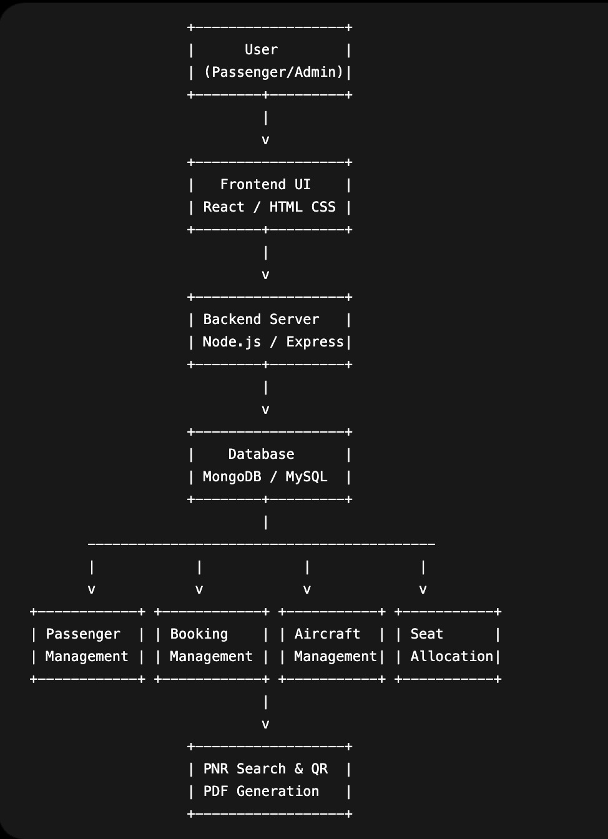

System Architecture

Slide 6

Technologies Used
Frontend
React.js
HTML5
CSS3
JavaScript
Backend
Node.js
Express.js
Database
MongoDB / MySQL
Additional Libraries
Axios
QR Code Generator
jsPDF

Slide 7
Major Modules:
CO1 | Frontend Architecture & UI DesignReact Frontend ArchitectureComponent-Based UI DesignDashboard LayoutResponsive User Interface
CO2 | JavaScript & Component DevelopmentJavaScript (ES6+)TypeScriptModular ComponentsAsync API CallsForm Handling
CO3 | React Components & State ManagementReact ComponentsProps & State ManagementLogin ComponentPassenger Registry ComponentPNR Search Component
CO4 | API Integration & AuthenticationAPI IntegrationAxios RequestsAuthentication FlowDashboard Data FetchingState Management
CO5 | Navigation & User ExperienceReact Router NavigationLogin ValidationPassenger Registration FormsUser-Friendly UIPerformance Optimization
CO6 | Backend & DeploymentVite Build SystemNode.js BackendExpress ServerEnvironment ConfigurationGitHub DeploymentProject Structure

Slide 8
Aircraft Management
This module allows administrators to: Add aircraft Edit aircraft Delete aircraft Manage seat capacity Example aircraft: Boeing 787 Dreamliner Airbus A380 Airbus A350

Slide 9

Booking Workflow
The booking process works as follows: Passenger enters travel information. Booking is created. Unique PNR is generated. Aircraft is assigned. Seat is allocated. Passenger details are stored. QR code and boarding pass are generated.

Slide 10
PNR Search
PNR Full Form: Passenger Name Record A PNR is a unique booking identifier used to retrieve passenger details. Using the PNR number, the system can display: Passenger information Flight details Seat number Travel route Booking status

Slide 11
QR Code and Boarding Pass
For every booking:
A unique QR code is generated.Passenger information is encoded.QR code can be scanned for verification.Boarding pass can be downloaded as a PDF. Benefits: Faster verification Improved security Reduced manual work

Slide 12
Advantages
The advantages of the system are: User-friendly interface Fast booking management Automated seat allocation Easy passenger tracking Secure data storage Digital boarding passes Reduced human errors

Slide 13
Future Enhancements
Future improvements include: Online payment integration Real-time flight tracking Mobile application support Email and SMS notifications AI-based seat recommendations Multi-airline management support

Slide 14
Conclusion
In conclusion, the SkyPNR Airline Management System successfully automates airline operations. The project provides: Passenger management Aircraft management Booking management Seat allocation PNR search QR code generation Boarding pass download This system improves operational efficiency, reduces manual effort, and enhances passenger experience.

Slide 15
THANK YOU

